Slide 1
“Know your MP”
Software Requirement Specification
01 July, 2013
Team Name: Lunatics
Team Mentor: Surendran
Submitted by:
Deepanshu Jain
Deepak kumar
M.Sc. Informatics

Slide 2
Introduction:
The purpose of this document is to present a detailed description of the Web Portal. This document is intended for both Administration section of Parliament, who will update data related to this portal regularly and common citizen.
With the penetration of mobile phones (both smart phones and feature phones), it is now possible to make MP’s information available to people easily.
We can use the attendance data to build an application that showcase their regularity in a format that is easily searchable.
This data will give people an understanding of regularity of their representative in the parliament or the assembly. This is crucial in strengthening our democracy by making an informed choice while casting our votes.

Slide 3
Languages & Tools:
HTML:
HTML known as Hyper Text Markup Language is the main markup language that has been used here for creating web pages and other information that can be displayed in a web browser.
PHP:
PHP popularly known as Hypertext Preprocessor is a server-side scripting language designed for web development and is also used as a general purpose programming language. This application uses php embedded in HTML code for designing dynamic web pages.
JQUERY:
JQuery is a multi-browser java script library designed to simplify the client-side scripting of HTML.

Slide 4
JAVA SCRIPT: java script is a client side scripting language . JavaScript resides inside HTML documents and can provide levels of interactivity to web pages which are not achievable with simple HTML.
CSS:
Cascading Style Sheet (CSS) is a style sheet language used to describe the presentation semantics ( the look and the formatting) of a document written in a markup language. CSS is designed primarily to enable the separation of document content (written in HTML) from document presentation.
My SQL:
My SQL has been used for creating and managing database information.

Slide 5
References:
Data required for this Web Portal has been taken
From the following links
Data for all the MPs has been fetched from this given URL:
http://india.gov.in/my-government/whos-who/members-parliament
Data regarding the regular attendance of each MP has been taken from link
http://164.100.47.132/members_attendance/mainscreen.aspx
Data regarding NEWS and SESSION of Parliament will be taken from provided link
http://www.prsindia.org/

Slide 6
Flowchart
.
START
Home
Contact MP
Attendance
Property
About the Parliament
And both of its Houses.
Gives contact details of the selected MP
Provides the data of Attendance of selected MP
Gives the property of the selected MP

Slide 7
USER INTERFACE:
How to use:
The Web Portal describes Attendance , Personal details and property of each MP of Parliament of India.
User just needs to select their state, accordingly the constituencies will be updated in the constituency tab, and user can select their desired constituency to get the information (Attendance according to session and Personal details ) about MP of that constituency.

Slide 8
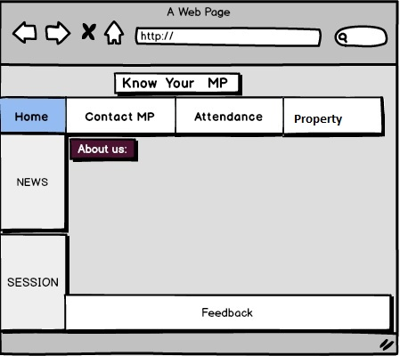
Wireframe of the Portal:
The web page shown will provide data of every MP .
HOME page will describe about the Parliament and its both the houses.

Slide 9
Contact MP Tab will show the contact details of selected MP with his/her image
Attendance Page shows the attendance of each MP according to session with percentage.
Property page shows about the property of each MP which he/she has.
Usage of the Web Portal:
This Portal provide with all the data of MP , which is good and well to decide the regularity of the MP of a particular constituency. People can use this data to decide and elect their
Constituency’s representative .

